Slide 1
Behaviours, Actors and Scenes

Slide 2
Do it Now
Complete the “Lesson 2 – Do it now task”
Then swap your work with a neighbour to be marked.
Learn how to use behaviours, actors and scenes in Stencyl

Slide 3
Answers
Instructions for computers can be summarised in flowcharts using special symbols and language.
The instructions in flowcharts are displayed in sequence this sequence is shown by the direction of the arrows connecting the symbols.
Learn how to use behaviours, actors and scenes in Stencyl

Slide 4
Learning Objective
“Learn how to use behaviours, actors and scenes in Stencyl”.
Write this Learning Objective into your book.
Tuesday, 27 May 2014

Slide 5
Homework
Next lesson we will begin to create our own version of Pacman
You can play Pacman on our weebly site if you don’t know what it is
Design the following on paper:
Pacman, ghosts and pellet actors
Your first scene
Learn how to use behaviours, actors and scenes in Stencyl

Slide 6

Introduction to Stencyl
Stencyl is a program that allows you to make games by putting instructions together.
This term you will be using it to make your own version of Pacman.
Learn how to use behaviours, actors and scenes in Stencyl

Slide 7
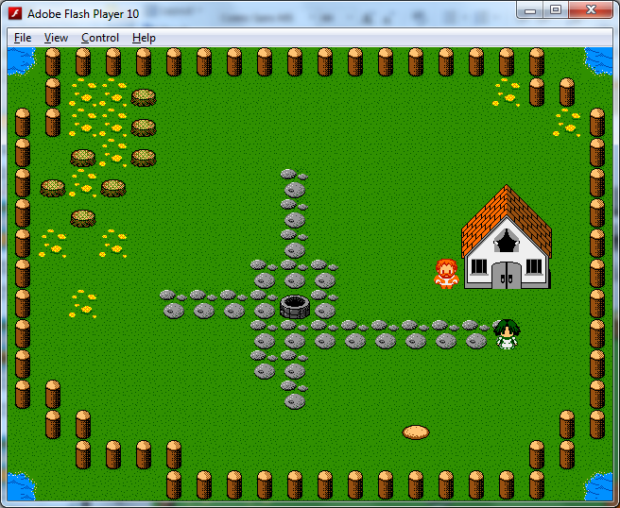
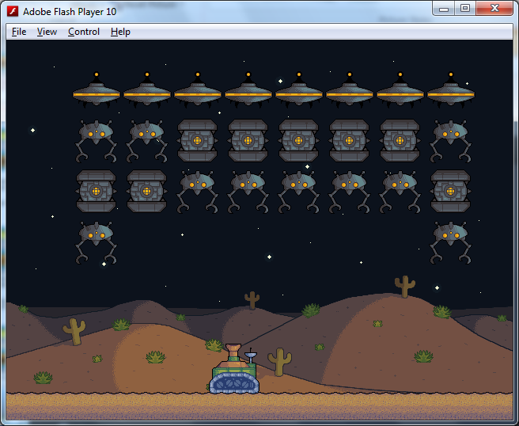
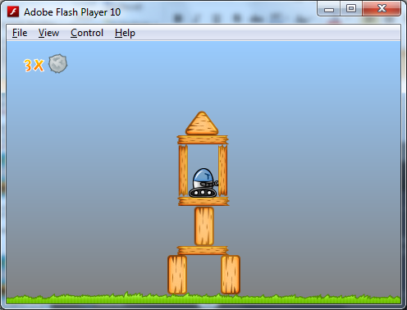
Scenes
Scenes are the different areas that a player can enter in your game.
Lots to import or you can make your own.
Learn how to use behaviours, actors and scenes in Stencyl

Slide 8
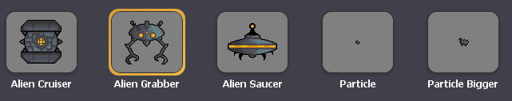
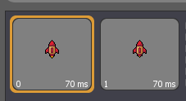
Actors
An actor is a character or object in your game.
Actors can be animated to make them look like they move:
Swapping between these two images would make this actor look like it’s engines are firing.
Learn how to use behaviours, actors and scenes in Stencyl

Slide 9
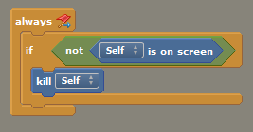
Behaviours
A sequence of instructions is called a behaviour.
In Stencyl instructions are put together like parts of a jigsaw puzzle:
In programming terms each behaviour is known as a procedure
Learn how to use behaviours, actors and scenes in Stencyl

Slide 10
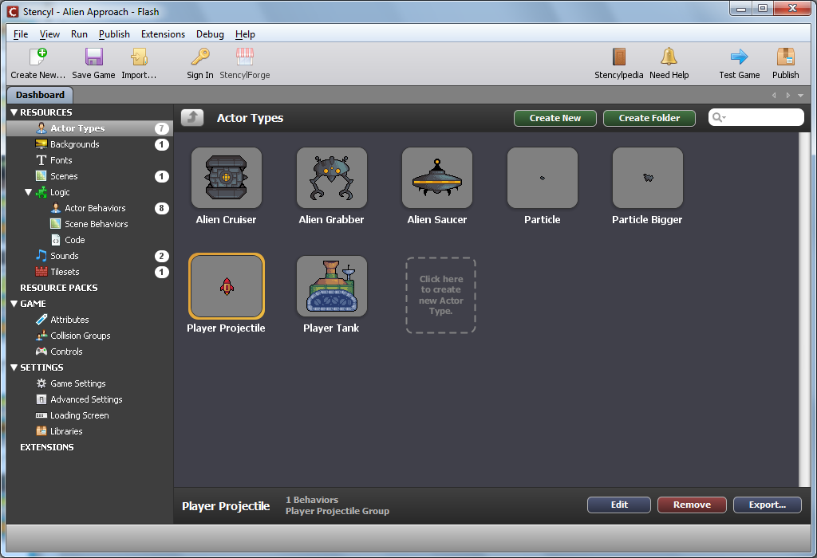
The Stencyl Interface
Save your game
Test your game
Here is where you access all the different resources for your game
All of the assets for the resource selected.
Learn how to use behaviours, actors and scenes in Stencyl

Slide 11
Task
Follow the instructions on the print out to create your first game in Stencyl
Learn how to use behaviours, actors and scenes in Stencyl

Slide 12
Extension Task
Download the assets for crashcourse 2 from our weebly site
Crashcourse 2 will encourage you to create some of your own behaviours
Learn how to use behaviours, actors and scenes in Stencyl

Slide 13
Learning Objective
“Learn how to use behaviours, actors and scenes in Stencyl”.
Tuesday, 27 May 2014

Slide 14
What can you remember?
What is an actor?
What is a behaviour?
What is a scene?
Learn how to use behaviours, actors and scenes in Stencyl

Slide 15
Learning Outcomes
Created a game that implements algorithms to achieve given goals
Knows that a procedure can be used to hide the detail with sub-solution (procedural abstraction)
Understands that programming bridges the gap between algorithmic solutions and computers
L3
L4
L5
Tuesday, 27 May 2014

