Slide 1
Creating actors and scenes

Slide 2
Do it Now
Complete the “Lesson 3 – Do it now task”
Learn how to create actors and scenes in Fireworks and import them into Stencyl

Slide 3
Learning Objective
“Learn how to create actors and tiles in Fireworks and import them into Stencyl”.
Write this Learning Objective into your book.
Tuesday, 27 May 2014

Slide 4
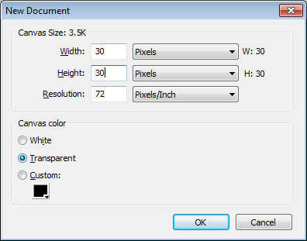
Creating your actors
Open Fireworks from
Start >
Programs >
Multimedia >
Adobe Design Premium >
Fireworks
Click on Create New Fireworks File
Set up the file as shown on the right
Learn how to create actors and tiles in Fireworks and import them into Stencyl

Slide 5
Creating your actors
Use the vector shapes to draw your pacman actor, this should be kept quite simple as you will need to use it in your game.
I used the pie tool to make his mouth open
Learn how to create actors and tiles in Fireworks and import them into Stencyl

Slide 6
Creating your actors
Create 4 different versions of your pacman actor. One with his mouth open, one with it closed and then a second set with him facing the opposite direction:
If your pacman is traditional like mine you only need three versions of the actor, why?
looking left
looking right
Learn how to create actors and tiles in Fireworks and import them into Stencyl

Slide 7
Creating your actors
Using the same settings as you used for your pacman (30 x 30 pixels, 72 DPI) create food for him to eat and some ghosts to chase him.
Try using filters to change how your actors look!
food
Ghost
Learn how to create actors and tiles in Fireworks and import them into Stencyl

Slide 8
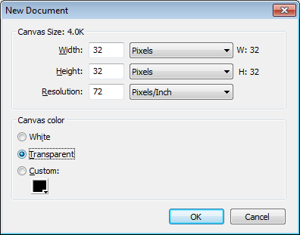
Creating your tiles
Remember that when you create scenes in Stencyl you use the same tiles over and over again. We are now going to create the tiles for our pacman game
Set up your fireworks
document as shown:
Learn how to create actors and tiles in Fireworks and import them into Stencyl

Slide 9
Creating your tiles
I have created tiles for each side of my maze and every corner. You can keep this simple by just creating squares if you want to. Don’t forget to include a tile for where pacman will move around!
NOTE: I have added a black outline to make it easier to see how I have designed each tile
Learn how to create actors and tiles in Fireworks and import them into Stencyl

Slide 10
Setting up your game
Now we will begin to add our actors and tiles to our pacman game.
To start with we need to set up a new game.
Learn how to create actors and tiles in Fireworks and import them into Stencyl

Slide 11
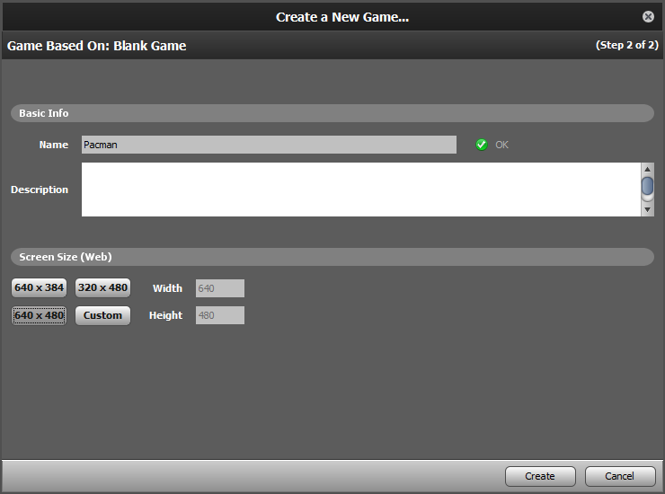
Setting up your game
Name your game and set up your screen size as shown
Learn how to create actors and tiles in Fireworks and import them into Stencyl

Slide 12
Importing your Actors
Select actor types and click in the box with the dotted lines
Learn how to create actors and tiles in Fireworks and import them into Stencyl

Slide 13
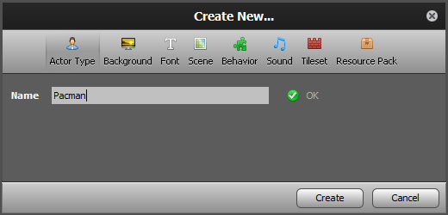
Importing your Actors
You are going to create your pacman actor first
Click in the dotted box to create your animations for pacman
Learn how to create actors and tiles in Fireworks and import them into Stencyl

Slide 14
Importing your Actors
Name the first animation Right
Click in the dotted box to add your first frame of your animation if pacman is moving right
Learn how to create actors and tiles in Fireworks and import them into Stencyl

Slide 15
Importing your Actors
Click on choose image and find your first pacman image
Learn how to create actors and tiles in Fireworks and import them into Stencyl

Slide 16
Importing your Actors
Repeat the steps to add the second frame of you animation for pacman moving right
Learn how to create actors and tiles in Fireworks and import them into Stencyl

Slide 17
Importing your Actors
You might need to slow the animation down – double click on each frame and increase the number – try 200 ms
Learn how to create actors and tiles in Fireworks and import them into Stencyl

Slide 18
Importing your Actors
Click on the + symbol on the bottom left to add the animation for pacman to move left.
Follow the same steps as before naming the animation left.
Once complete you can close the pacman actor and go back to your dashboard.
Learn how to create actors and tiles in Fireworks and import them into Stencyl

Slide 19
Importing your Actors
Create actors for food and ghosts
As these do not have animations – you can name the animation normal
Learn how to create actors and tiles in Fireworks and import them into Stencyl

Slide 20
Importing your actors
For each Actor type, click on Physics and set up as follows:
Ghosts and food
Pacman
NOTICE: NORMAL!
Learn how to create actors and tiles in Fireworks and import them into Stencyl

Slide 21
Importing your actors
For each Actor type (food, pacman and ghosts), click on Collisions, delete the existing collision region and create a new one:
Click here for new region
Do this for both animations
Make sure the collision region is the same size as the actor
Learn how to create actors and tiles in Fireworks and import them into Stencyl

Slide 22
Importing your Tiles
Select Tilesets from your Dashboard
Click in the dotted box
Name the tileset ‘Level one tiles’
Learn how to create actors and tiles in Fireworks and import them into Stencyl

Slide 23
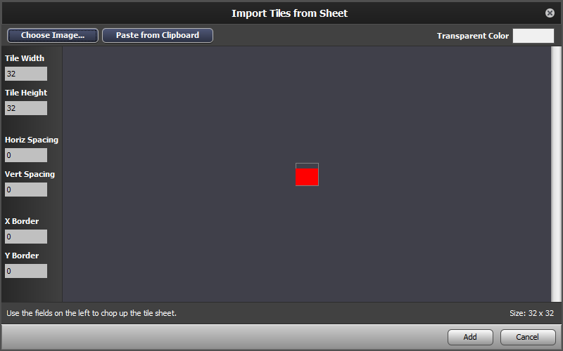
Importing your Tiles
Click on choose image and add your first tile
Learn how to create actors and tiles in Fireworks and import them into Stencyl

Slide 24
Importing your Tiles
Click on import tiles from sheet and add all of your tiles one at a time
Learn how to create actors and tiles in Fireworks and import them into Stencyl

Slide 25
Importing your Tiles
You now need to set up the collisions to prevent pacman from walking through walls. All of your maze walls should be set up like this:
Your ground should have No Collisions
Your tileset is now ready to use
Learn how to create actors and tiles in Fireworks and import them into Stencyl

Slide 26
Setting up your first scene
From the dashboard click on scenes, add a new scene and name it level one.
Add a background colour.
Using the pencil tool add all of your tiles to create the maze that pacman will move in.
Learn how to create actors and tiles in Fireworks and import them into Stencyl

Slide 27
Setting up your first scene
Now select Actors from the right hand of the screen
Add pacman, some food and some ghosts to your game.
The arrow tool will let you select and delete any mistakes and move things around once they are placed with the pencil tool
Learn how to create actors and tiles in Fireworks and import them into Stencyl

Slide 28
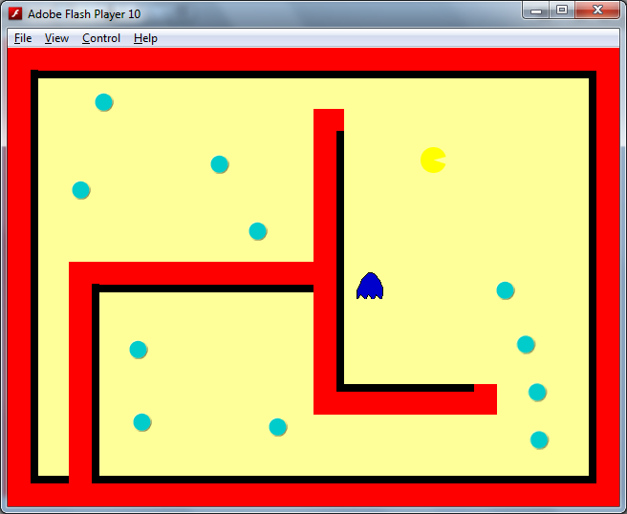
Testing your game
Click to test your game
Learn how to create actors and tiles in Fireworks and import them into Stencyl

Slide 29
Extension Task
Download the assets for crashcourse 2 from our weebly site
Crashcourse 2 will encourage you to create some of your own behaviours
Learn how to create actors and tiles in Fireworks and import them into Stencyl

Slide 30
Learning Objective
“Learn how to create actors and tiles in Fireworks and import them into Stencyl”.
Tuesday, 27 May 2014

Slide 31
What can you remember?
What is a tile?
How are tiles used in a scene?
Why did you need to use separate software to create your actors and tiles?
Learn how to use behaviours, actors and scenes in Stencyl

Slide 32
Learning Outcomes
collect, organise and present data and information in digital content.
create digital content to achieve a given goal through combining software packages to communicate with a wider audience
know the audience when I am designing and creating digital content
evaluate the appropriateness of digital devices and application software to achieve given goals
L3
L4
L5
Tuesday, 27 May 2014

