Slide 1
Finishing your game

Slide 2
Homework
Play lots of computer games over the summer and think about how they have been made – can you work out how to make any of them in Stencyl?
Learn how to add features to a game in Stencyl to make it better

Slide 3
Learning Objective
“Learn how to add features to a game in Stencyl to make it better”.
Write this in your book.
Wednesday, 28 May 2014

Slide 4
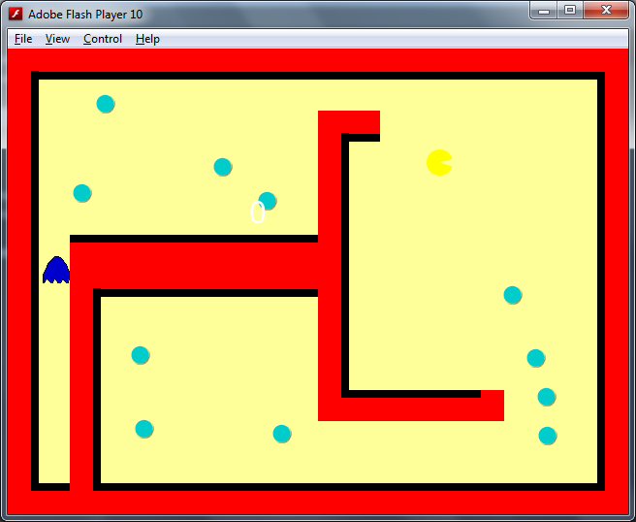
Last Lesson
You made a version of pacman
Learn how to add features to a game in Stencyl to make it better

Slide 5
Peer Assessment
Swap seats with the person next to you.
Play your partners pacman game and complete the peer review sheet your teacher gave you.
LEVEL 5 challenge: create your own peer review sheet for your tester to use
Can you make any improvements based on their suggestions?
Learn how to add features to a game in Stencyl to make it better

Slide 6
Learning Objective
“Learn how to add features to a game in Scratch to make it better”.
Wednesday, 28 May 2014

Slide 7
What can you remember?
Why is it important to add as many features as possible into a game?
Why is it a good idea to get somebody else to try out your games?
Learn how to add features to a game in Stencyl to make it better

Slide 8
Self Assessment
Assess what you’ve done by completing the statements on the self assessment sheet your teacher has given you.
Learn how to carry out a self assessment

