Slide 1
Do it now – PAGE 12
You will find your do it now task in your workbook – look for the start button!
Sunday, 1 February 15

Slide 2
Home learning
Revise for your end of term assessment next lesson!
Your marks for the end of term assessment will go on ShowMyHomework
DUE:

Slide 3
Instructions

Slide 4
Learning Objective
“Investigate how computers follow instructions”
You will find differentiated outcomes for this lesson on the front of your workbook.
Sunday, 1 February 15

Slide 5
New learning
INSTRUCTIONS
Investigate how computers follow instructions
Notes:
This is the way the computer views the instructions I have written to control a screen turtle.

Slide 6
New learning
Investigate how computers follow instructions
Notes:
These are how my instructions look when I write them using a programming language called Python.
All of the software you use on your computer will have been written using a programming language which converts the instructions typed into binary which can be understood by the computer.
In early computers the programming had to be done manually by connecting up wires – watch video on next slide

Slide 7
New learning
https://www.youtube.com/watch?v=C3dLwtwdEjM
Investigate how computers follow instructions
Notes:
how instructions are run inside a computer

Slide 8
Independent Task
Complete the activity in your booklet on p12
Investigate how computers follow instructions

Slide 9
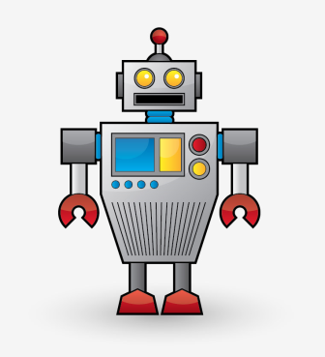
Learning Development
Jambot
Jambot makes jam sandwiches
Tell it what to do!
Make a sandwich
Investigate how computers follow instructions
Notes:
So how does the computer know what the sound sounds like?
Join the dots…you need to draw your own dots though! Here they are:
On the X axis, put a dot at the following co ordinates. Have a go at drawing the sound wave
You have just done what the computer does to reassemble an audio file.
To record a sound, the computer SAMPLES (aka, measures) the sound at regular points, (frequency). Then it converts the sample measurements into binary code.

Slide 10
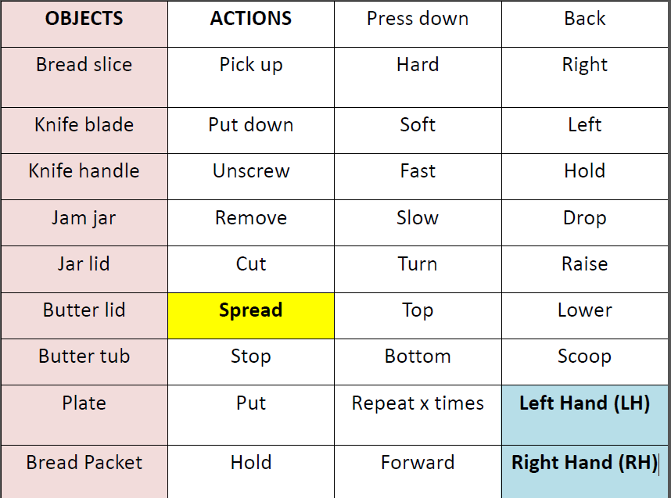
Learning Development
Investigate how computers follow instructions
Notes:
Pupils need to write a series of instructions that only use the words provided. Each command must contain a left or right hand indicator. You could demo making a sandwich but don’t use the commands.
•Pupils need to be both challenged to be accurate and encouraged to refine and debug their instructions as a normal part of computing.
•As the robot be pedantic and petty. Do exactly what pupils tell you even if it involves putting your hand in the butter or jam.
•See the accompanying video to see common errors and examples that are correct. Don’t show the videos to pupils.
http://www.youtube.com/watch?v=leBEFaVHllE
•Pupils can split two word commands and use only one eg Jam or Jar
•If you have another adult in the class get them to be bots as well.
This will be students assessed task this week

Slide 11
Independent Task
Complete the activity in your booklet on p13
Investigate how computers follow instructions

Slide 12
Talk Task
What is the word for a single step in what a computer does?
What is meant by an instruction set?
How would you use an instruction to get the JAMBOT to do what you want?
What instructions are needed to open the jam jar?
Can you suggest a better way to program rather than doing each instruction one at a time?
Based on what you know explain how a computer follows instructions.
Investigate how computers follow instructions

Slide 13
Exit ticket
What do computers follow?
R A G
Investigate how computers follow instructions

