Slide 1
Do it now activity
How likely it is that Garry Dury is the murderer?
How do you know he is the murderer?
What type of evidence do you have?
Is this evidence reliable?
How could you make sure that you have the right person?

Slide 2
Homework
Questionnaire
Make notes on your printout from todays lesson to explain what you have done and what the report shows.
Use the homework sheet for help with your notes
Due:
Notes:
This term your homework will be around a theme -

Slide 3
Learning
AIM
Create a report based on your findings

Slide 4
Learning
objectives
Take screenshots and explain your processes
Create database reports using the Report Wizard

Slide 5
Learning
objectives
Take screenshots and explain your processes
Create database reports using the Report Wizard
By the end of the lesson
ALL (Level 3) | I can make judgements about digital content when evaluating and repurposing it for a given audience.
MOST (Level 4) | Analyse and evaluate data and information, and I know that poor quality data leads to unreliable results, and inaccurate conclusions.
SOME (Level 5) | I can evaluate the appropriateness of digital devices, internet services and application software to achieve given goals.

Slide 6
Learning
objectives
Take screenshots and explain your processes
Create database reports using the Report Wizard
Solving the crime
Now the murderer has been arrested, Detective Turner needs to make sure that the case against him is watertight. In order to do this, he needs to be able to explain to the judge exactly how you found the murderer. You will need to present this in the form of a word-processed document.
Filters Data
Queries
Database Reports
Interrogate
Notes:
New learning

Slide 7
Learning
objectives
Take screenshots and explain your processes
Create database reports using the Report Wizard
New learning
Open Y7 T4 L5 - Starter and complete the worksheet with a partner. Remember to save your work!
Filters Data
Queries
Database Reports
Interrogate
Notes:
New learning

Slide 8
Learning
objectives
Take screenshots and explain your processes
Create database reports using the Report Wizard
Talk Task
Go to your folder for this unit (Unit 7.5 – Murder Most Horrid) and locate the document you saved when you found out who the murderer was last lesson.
You are going to perform the same searches again but this time you will need to provide evidence that you have performed the searches by taking screenshots of your results.
Open Lesson 5 Database and take a minute or two to explain to a partner how to make a query Can you remember how? Discuss the steps as a class.
Filters Data
Queries
Database Reports
Interrogate
Notes:
New learning

Slide 9
Learning
objectives
Take screenshots and explain your processes
Create database reports using the Report Wizard
Learning development
You need to make a word-processed document that has screenshots of results from each of the filters. This also needs to explain exactly what you have searched for. Your teacher will show you how to perform a screenshot.
Open Y7 T4 L5 – Main activity. You need to save this into your folder for this unit.
Now perform each search from last lesson again, this time taking a screenshot of each filter. Paste these into your saved version of Y7 T4 L5 – Main activity, and add annotations to show how the crime was solved.
Filters Data
Queries
Database Reports
Interrogate
Notes:
New learning

Slide 10
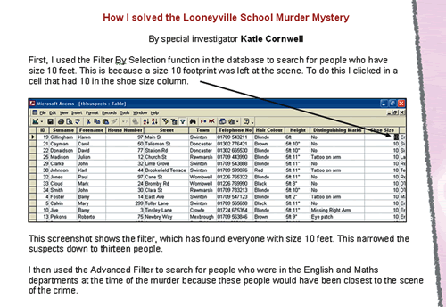
Learning
objectives
Take screenshots and explain your processes
Create database reports using the Report Wizard
Learning development
Filters Data
Queries
Database Reports
Interrogate
Notes:
New learning

Slide 11
Learning
objectives
Take screenshots and explain your processes
Create database reports using the Report Wizard
Find the relevant information
Detective Turner needs you to find the following information:
People who were in the English department
People who were in the Maths department
People who were in Reprographics
Make a query for each of the above. For each query you will need to include the following fields:
'ID', 'Surname', 'Forename', 'Hair Colour', 'Shoe Size', 'Distinguishing Marks', 'Height', 'Alibi'.
Filters Data
Queries
Database Reports
Interrogate
Notes:
New learning

Slide 12
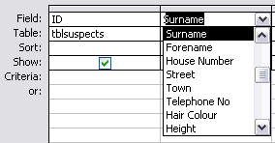
Learning
objectives
Take screenshots and explain your processes
Create database reports using the Report Wizard
Find the relevant information
Detective Turner needs you to find the following information:
People who were in the English department
People who were in the Maths department
People who were in Reprographics
Make a query for each of the above.
For each query you will need to include the following fields:
'ID', 'Surname', 'Forename', 'Hair Colour', 'Shoe Size', 'Distinguishing Marks', 'Height', 'Alibi'.
Filters Data
Queries
Database Reports
Interrogate
Notes:
New learning

Slide 13
Learning
objectives
Take screenshots and explain your processes
Create database reports using the Report Wizard
Use the 'Report Wizard'
Now that you have made these queries, Detective Turner would like to be able to print out the information.
Detective Turner needs to be able to print out the information about the suspects. Look again at the database and open the suspects table in Datasheet View. Imagine this is a printout of the table (or print out a copy). How easy or difficult would it be for the detective to find the witnesses' names and addresses from this table? Discuss your ideas as a class.
Filters Data
Queries
Database Reports
Interrogate
Notes:
New learning

Slide 14
Learning
objectives
Take screenshots and explain your processes
Create database reports using the Report Wizard
Use the 'Report Wizard'
Now open the shoe size query report on the database. Watch as your teacher demonstrates how to make a report.
You are going to use the 'Report Wizard' to make a report based on the English department query. Find out how to do this by watching How to use report wizard
Filters Data
Queries
Database Reports
Interrogate
Notes:
New learning

Slide 15
Learning
objectives
Take screenshots and explain your processes
Create database reports using the Report Wizard
Use the 'Report Wizard'
Now you create a report for each of the following:
People who were in the English department
People who were in the Maths department
People who were in Reprographics
Remember to:
Select the query you want to base the report on
Add all the fields to your report
Change the orientation of your report to landscape
Choose a report style
Give your report a title
Filters Data
Queries
Database Reports
Interrogate
Notes:
When you click on Finish, the report should open in 'Print Preview' so that you can see what it will look like when you print it. If you are happy with the report, print it out. Remember to save your work!

Slide 16
Learning
objectives
Take screenshots and explain your processes
Create database reports using the Report Wizard
Round it up
As a class, discuss the best method of presenting information. Can you explain to a partner or to the class how to make a report?
Filters Data
Queries
Database Reports
Interrogate
Notes:
When you click on Finish, the report should open in 'Print Preview' so that you can see what it will look like when you print it. If you are happy with the report, print it out. Remember to save your work!

Slide 17
Learning
objectives
Take screenshots and explain your processes
Create database reports using the Report Wizard
Check your progress:
ALL (Level 3) | I can make judgements about digital content when evaluating and repurposing it for a given audience.
MOST (Level 4) | Analyse and evaluate data and information, and I know that poor quality data leads to unreliable results, and inaccurate conclusions.
SOME (Level 5) | I can evaluate the appropriateness of digital devices, internet services and application software to achieve given goals.

